Slide 1
Track & Field Handbook
Presented By:
Your Coaching Staff

Slide 2
Coach | Position
Dylan Reynolds | Head Coach/Sprints
Paul Reneau | Sprints
Jace Dewalt | Hurdles
Kristy Mcelmurry | Hurdles
Jerrod Akins | LJ and TJ
Alex Akins | HJ
Mackenzie Schoustra | HJ
Nick Trebesch | Pole Vault
Nate Bache | Javelin
Sarah Pfeifer | Discus
Oliver Grajeda | Shotput/Discus
Shawn Bishop | Shotput/Discus
Diego Hammett | Distance
Colt Mortenson | Distance
Chris Jones | Mid-Distance
Chris Casadei | Mid-Distance

Slide 3
Participation Check-List
Physical
If you have not played a fall or winter sport, please see me after.
Must have physical done before we can practice.
Paper work/White Fee
Online registration: DragonFly.
Only if you have filled out the proper paper work, and paid your white fee do you get your gear and the ability to participate in the first meet.
You can still practice without paper work/white fee, you just do not get to participate in the first meet (March 31th).
Transfers: Anyone in who has not participated in sports this year, who has transferred?

Slide 4
Calendar Terms
A Day = Primary Event
B Day= Secondary Event
(try more than one events, you are rewarded for participating in four events.)
Split Day= Both Events
Generally will be the day before a meet.
Recovery Days
Full Team
30-45 minutes

Slide 5
March
13 | 14 | 15 | 16 | 17 | 18
First Day Sign-ups an Expectations Don’t Dress Out | A Day First Practice Day Fundraiser Starts | B Day | A Day | B Day | Spring Break Begins
20 | 21 | 22 | 23 | 24 | 25
Mixed A/B Days Practice Times Vary See website for times | Mixed A/B Days Practice Times Vary See website for times | Mixed A/B Days Practice Times Vary See website for times | Mixed A/B Days Practice Times Vary See website for times | Mixed A/B Days Practice Times Vary See website for times
27 | 28 | 29 | 30 | 31
A Day | B Day Team Values | A Day | Split Day | First Meet MCPS Stadium

Slide 6
April
3 | 4 | 5 | 6 | 7 | 8
A Day Picture Day | B Day | Split Day | Meet Day @ Helena (Open) | Recovery Day Goal Setting
10 | 11 | 12 | 13 | 14 | 15
A Day | Split Day | Meet Day MCPS Stadium (Open) | B Day | Split Day | Meet Day MCPS Stadium (Invite)
17 | 18 | 19 | 20 | 21 | 22
A Day | B Day | A Day | Split Day | Meet Day (Boys) @Butte (Invite) | Meet Day (Girls) @ Great Falls (Invite)
24 | 25 | 26 | 27 | 28 | 29
Split Day | Meet Day Top Ten MCPS Stadium | Split Day | Meet Day @Glacier (Open) | Recovery Day | Meet Day @Helena (Invite MCPS Stadium (Freshman)

Slide 7
May
1 | 2 | 3 | 4 | 5 | 6
Split Day | Meet Day MCPS Stadium | A Day | B Day | Recovery Day Coaches’ Competition
8 | 9 | 10 | 11 | 12 | 13
A Day | B Day | Split Day | Meet Day MCPS Stadium | Team Activity
15 | 16 | 17 | 18 | 19 | 20
A Day | B Day | A Day | Split Day | Divisionals Day 1 @ Helena | Divisionals Day 2 @ Helena
22 | 23 | 24 | 25 | 26 | 27
A Day | B Day | A Day Gratitude | Travel Day Practice @ Butte | State Day 1 @ Butte | State Day 2 @ Butte

Slide 8
Track 101
Two types of shoes—BRING THEM EVERYDAY
Event Shoes- (Spikes, Jav Boots, HJ Shoes, Etc)
Only wear event shoes during your event at meet, or when your coach asks you to change into them during practice. Bring them ever day
Flats- Daily running shoes-
Show up to practice in these, wear them every day and plan to practice in them unless you are advised by your coach not to.
Talk to your coach about what shoes/spikes if you have any questions before purchasing. We provide the spikes

Slide 9
Attire
Spartan Colors Only
Exception to this rule: Snowing, Raining---just stay warm.
MUST be wearing the team sweat shirt for warm up at all meets.
For meets, we warm-up in our grey sweats and black Under Armour bottoms--everyone and always!
Bring multiple pairs of socks to meets. It’s okay to not where socks with your running spikes, that’s normal in the track world.
If you wear a shirt under your jersey, it must be a dri-fit (No sweatshirts.)
We provide the jersey, but you provide the all black bottoms. No large logos or any other colors.

Slide 10
Warm Up/Cool Down
In order to put yourself in a place to be as successful as you can be, we all must get our heart rate up and get blood flowing to our muscles; this means you need to be sweating.
This is applicable for practice and after each event at a meet; you must cool down.
We will do a dynamic warm-up as a team in the gym everyday 5-10 minutes max

Slide 11
Daily Practice Routine
Sign in on your assigned clipboard
Sit down in your squad line
We will do “THE BRIDGE” for 3 minutes
Coach Reynolds will go over Daily Announcements
Coach Trebesch will do Team warm-up and break us down
You will head to where your event coach is holding practice

Slide 12
What athletes and parents can expect from coaches:
Informed, Qualified, and Dedicated to our athletes well-being, health, and success.
We will always strive to learn more about the events we coach
A healthy and positive environment
Organized and good communicators.
Clear and consistent messages throughout the year.
Routine-The practice routine (pre-practice) will be the same as the meet routine.

Slide 13
What coaches expect from the athletes:
1. Commit yourself both on and off the track.
~Do the best you can.
2. Be on time and be ready to work hard everyday!
Encourage each other. You are committed to the team and our policies will follow that.
Constantly communicating with coaches when you will be gone, when you will be at other events and most importantly when you don’t feel healthy.
Proactive, not Reactive.

Slide 14
What coaches expect from the athletes:
8. Concentrate on Academics! We will have grade checks and they are FINAL!
~Make it to all classes;
~You cannot practice/participate in meets if you have an unexcused absence from school;
~Stay on top of your work;
We will have multiple grade checks this year
10. Dress Code-White fee pants and long sleeve. School issued sweatshirt. Pants worn at waist level.
11. NO UNEXCUSED ABSENCES FROM PRACTICE.
If you skip a practice, you miss the next week. End of Story

Slide 15
Unexcused Absences
Pre-Arrange
Fill out a pre-arranged Google Form
Can be found on our TF website
Remind
Send a remind message to me if you are sick.
THERE WILL BE NO EXCUSES for lack of communication.

Slide 16
Coachable/Accountable
Any athlete who takes coaching at Meets from individuals who are not Sentinel coaches will immediately be scratched and DQ’d for the rest of that event for that meet and will be suspended for the following meet.
This is a liability issue that we will not condone at Sentinel.
Accountability does not mean to be controlled by coaches and teammates. It is about being aware and conscious of them and the expectations. We are not a one person teams

Slide 17
Program Philosophy
Weight room is huge for our overall success:
Injury prevention
Strengthens athletes performance
We encourage students to be multi-sport athletes:
There are several dangers involved in focusing solely on one sports
Burnout.
Over-use injuries.
Inability to enhance your athletic ability.
Students are too young to be able to predict where they will be successful.

Slide 18
Meets-Few Things
We warm up as a team
Exceptions: Throwers/Pole Vaulters start earlier and they need to get their event specific warm up in.
Be there on time (Home=MCPS-Away=Bus)
If not, no participation in events, you get to work the meet where you are assigned.
No headphones while warming up on track (DQ) or on fields (Injury from flying implements).
Support each other
If you leave MCPS without checking out with Coach Reynolds, you miss the next meet.

Slide 19
Meets-Few Things
3 Types of Meets
Varsity Meets
Top 3-5 athletes in each event compete
Open Meets
The whole team competes if eligible
Freshman Meet
All Freshman compete and the rest of the team runs the meet and cheers on the Freshman

Slide 20
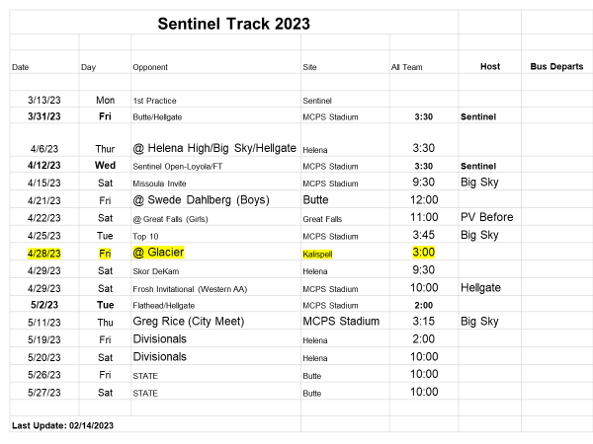

Slide 21
Divisionals and State
Divisionals
Top 5 in each event compete
Qualify for state by finishing in top 6 or hit the pre-qualifying standard at this meet or anytime during the season
You can only compete in 5 total events
State
Compete in 5 individual events and 2 relays

Slide 22
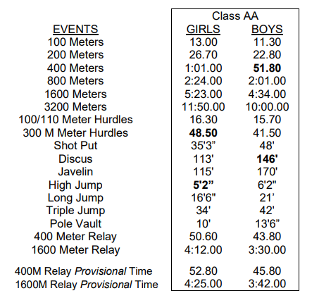

Slide 23
Meet Participation
Participation
First thing, it is a MHSA requirement that ALL athletes have 10 practices in before the first competition.
If you miss ANY class the day of a meet for any reason other than a medical issue, you will not participate in that days meet.
If you had any unexcused absences from practice, or miss practice because of participation in another sport, you will not be allowed to participate in that weeks meet. Please plan other activities accordingly around our weekly practice schedule (3:20-5:30).

Slide 24
Travel
Travel
All athletes must travel TO the meet with the team. After the meet is OVER you may then travel home from the meet with your parent/guardian.
If you want to go home from a out of town meet with someone other than mom/dad you must have our AD, Steph, approve the arrangement at least one day in advance of the meet.

Slide 25
Lockers
If you were winter athlete (Basketball/Wrestling) you may keep your winter sport locker.
If you were not a winter sport athlete, you will get your locker AFTER you have completed your physical, paper work, and paid your white fee.
Please use these locker rooms to keep all your gear safe and sound.

Slide 26
Uniforms
Seniors →Juniors → Sophomores→ Freshman
White fee gear:
Starting tomorrow, I will start passing out sweat bottoms and tops to those who have paid their white fees.
I will go off the sheet I receive from the main office.

Slide 27
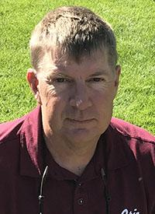
SPARTAN Team Building
Values- SERVE
Goal Setting
Gratitude
Dr. Charlie Palmer
· Ed. D, Counselor Education, emphasis in sport, Montana (2002)

Slide 28
Mission and Vision of Spartan Track and Field
Mission: To provide a safe, fun and supportive environment that fosters student-athletes’ personal growth through academics, community work and athletics.
Vision: To be the preeminent Track and Field program in the state of MT.

Slide 29
Non-Negotiables
Culture
Respect the environment, standards and rules
Character
Be a good person, teammate, coach and co-worker
Intent
Have a purpose and know why you are here

Slide 30
Keys to our success:
Relationships:
Get to know your teammates and coaches. No cliques; we cannot be successful with cliques. Develop a FAMILY attitude.
Passion:
You’re here for a purpose. Do not put time into things that you are not passionate about.
Mentality:
Being able to refocus yourself in stressful situations is paramount to your performance. Mental training will be our edge.

Slide 31
The Bridge
Our mental focus will allow us to do things that we have not done before. In order to do this we must train our mind to let go and move on to the next part of our day.
Every day before practices we will create a bridge from the school day to our practice.
In order to do this we will shed all things that occurred from 9AM- 4 PM and create a blank slate for Track and Field.
We will take a 3 minute break before practice to close our eyes, focus on our breath, and create space for practice.
If you don’t take this serious, you’ll be told to leave.

Slide 32
SERVE
Track may feel like an individual sport, but success teams are not.
How can you serve the team?
What is best for the team?
What is best for your teammates?
What does a successful track meet look like for the team?

Slide 33
White Fee Gear:
Must have paid your fees:
SR: Today
JR’s: Lunch Tuesday
SO: Lunch Wed
Frosh: Lunch Thurs
Uniforms:
We will pass those out next week
After the CITY MEET, I will collect all uniforms from those who are not going on to Divisionals.

Slide 34
Fundraiser
Vertical Raise
We have a set goal of $40,000.
Ask Parents/Aunts-Uncles/Grandparents/Family friends
We will kick off next Tomorrow the 14th.
20 emails per person, if you have them tomorrow you will be entered to win $100 gift card and UpTop Sentinel Hat
Fake emails will get you disqualified.
You will be put into your event group. Top event group gets new gear. (top 5 in your event group)
You want new equipment, your group better fundraise, Coaches Included.
Top Raisers will get a prize.

Slide 35
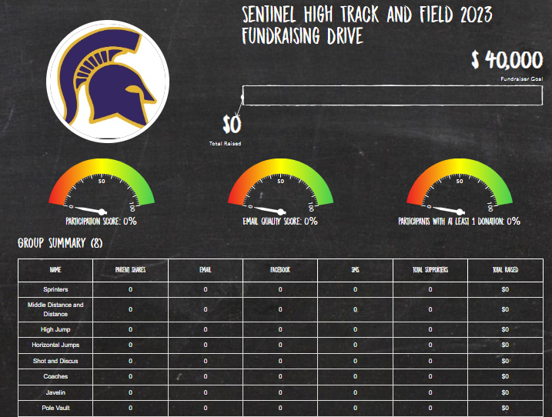
Fundraiser

Slide 37
Photos
Photos will be Monday April 3rd.
Get an envelope from the office if you want individual photos
Grey Top and Black sweats
No hats or glasses

Slide 38
Squad Lines/Captains
You will be able to choose your squad lines
I would like these to be intermixed amongst genders, grade levels and events.
After we hit the computer labs, we will come back to the gym and get in our groups to make the squad lines.
Captains:
Shaun Liechty
Ava Kellenberg
Anneke Kuchenbrod
Ruby Lorenz
Jake Johnston

Slide 39
Apps to Download
Remind @SENT23TF
HUDL
hudl.com/jointeam
Team code qb9vvka

Slide 40
From here:
Freshman-Library Lab (Pfeifer, Grajeda, Bache)
Sophomores-Cafeteria Lab(Hammett, Reneau, J. Akins)
Juniors- Room 208 (Trebesch, Bishop, Jones)
Seniors- Chromebooks (Reynolds, Dewalt, A. Akins)
Log on to the computer, head to the TF website and complete the “TF Athlete Form”.
Everyone Return to Gym afterwards
Event groups will go with coaches to set-up their event areas and meet this coaches

Slide 41
I need to see the following:
Ava Kellenberg
Emily McElmurry
Keagen Crosby
Malia Bradford
Hudson Lembke
Ruby Lorenz
Karsen Beitz

